Slide 1

The Drive By Project
Software Manager: Dirk Thieme
Hardware Manager: Erik Manis
Project Controller: Mohammed Ansari

Slide 2
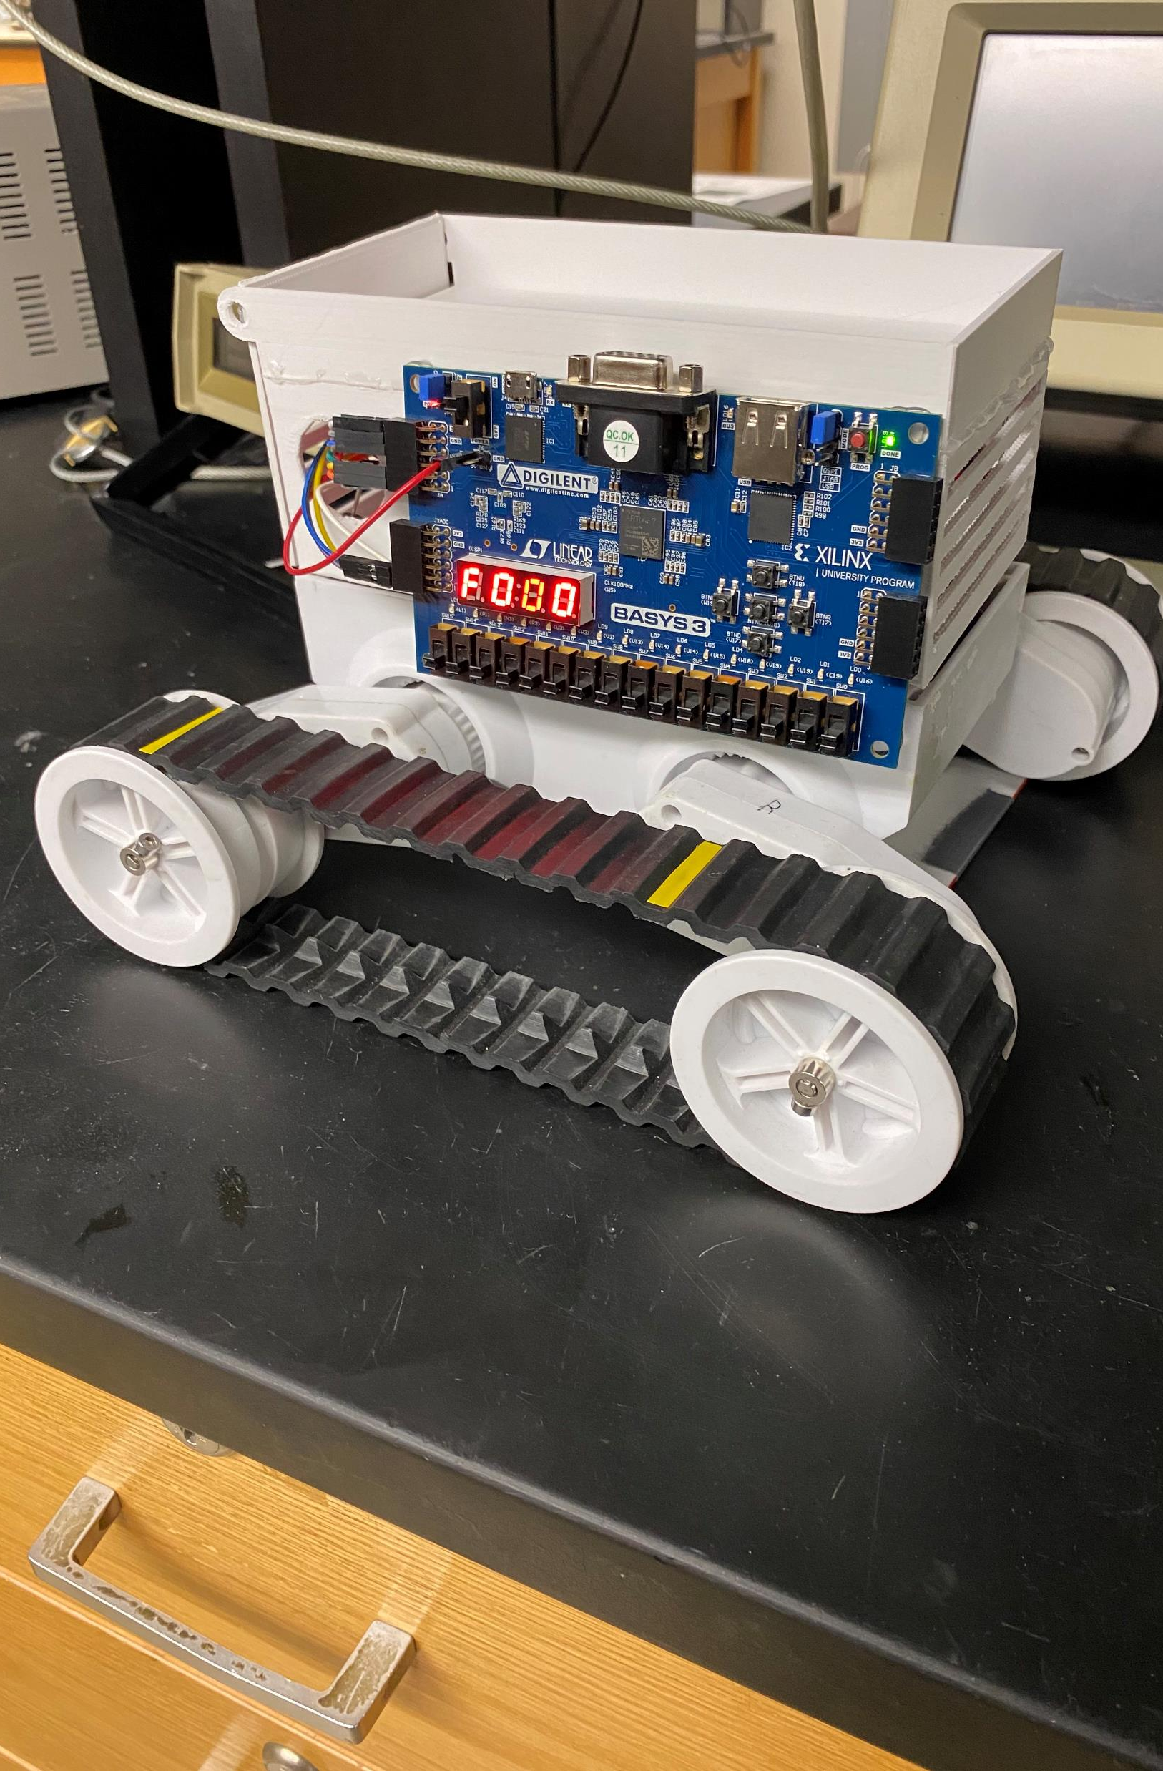
The Project Description & Objectives
Using a BASYS board, H bridge board and sensors to make a rover move along a metallic path and identify friendlies and hostiles along its path while also shooting the enemies by firing rubber bands at them

Slide 3
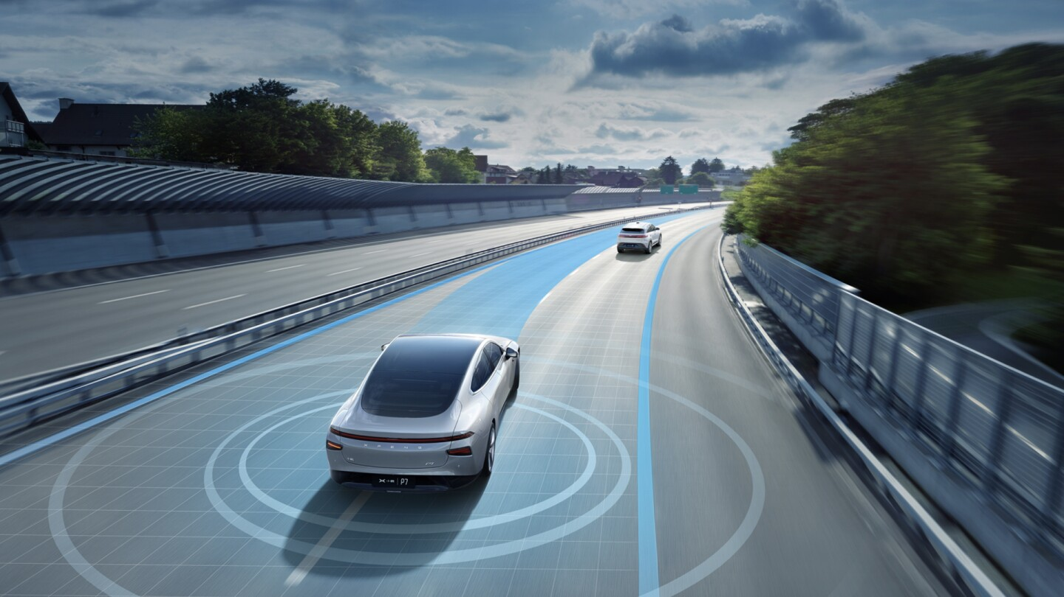
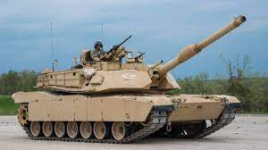
Project Opportunity
Military use : The rover’s capability could be enhanced to rival that of a military tank by improving the armor and the weapon placed on top of it
Self driving : The rover’s IR sensor could be replaced with other sensors that could track the path a self driving car would have to go on. The phototransistors could also be replaced with something that would detect other stuff that is close to the vehicle

Slide 4
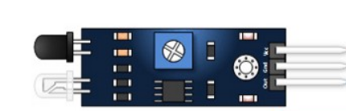
Hardware | HW-201 IR Sensor
It consists of an IR emitter which emits the signal and an IR receiver which detects the reflected signal
The IR receiver has a range from 2cm to 30 cm and is adjustable with a potentiometer
It has a 35-degree Detection Angle
It operates at a DC voltage range of 3.3V – 5V

Slide 5
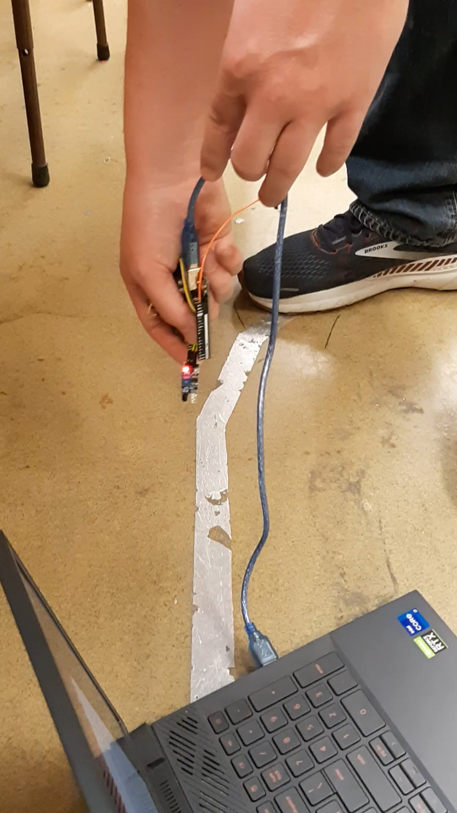
Hardware

Slide 6
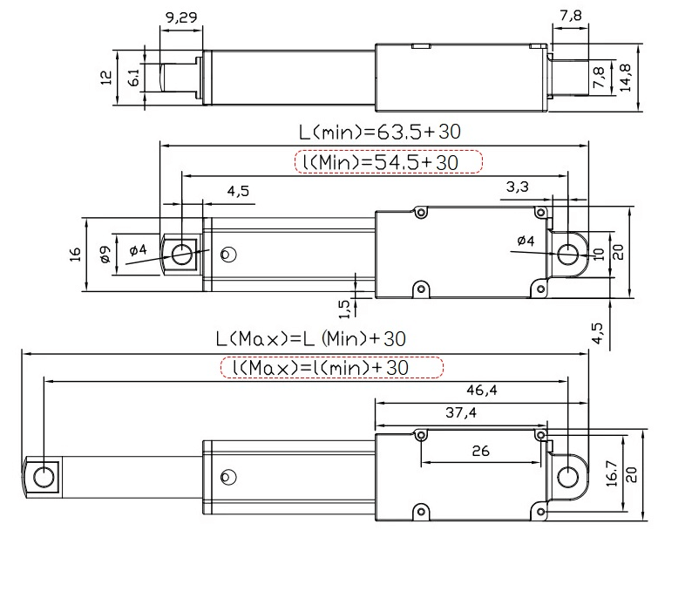
Hardware
6V Actuator

Slide 7
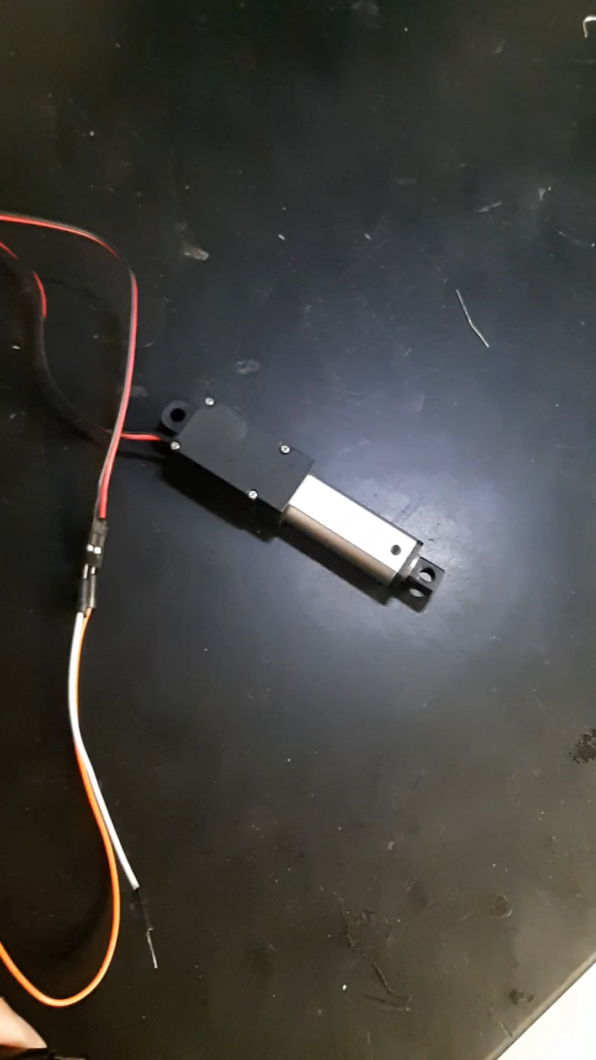
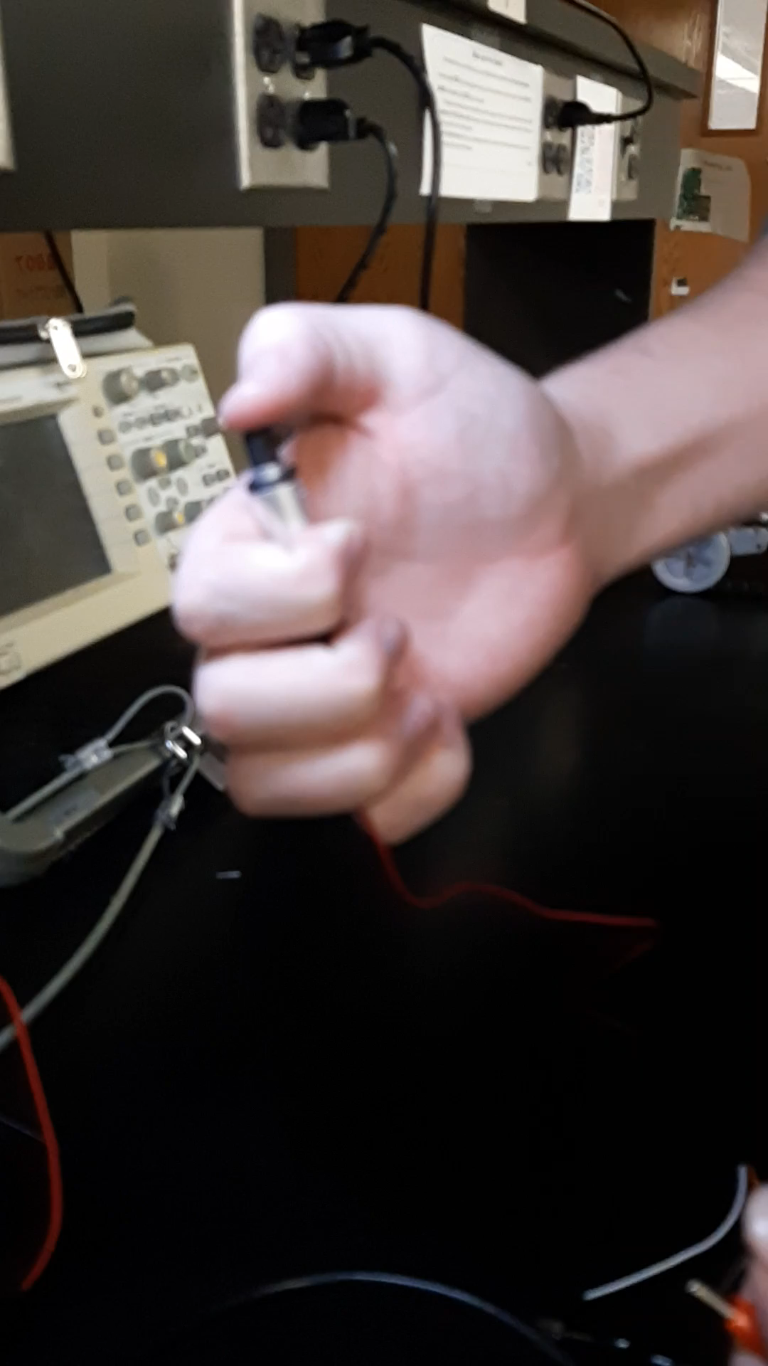
Hardware
6V Actuator

Slide 8
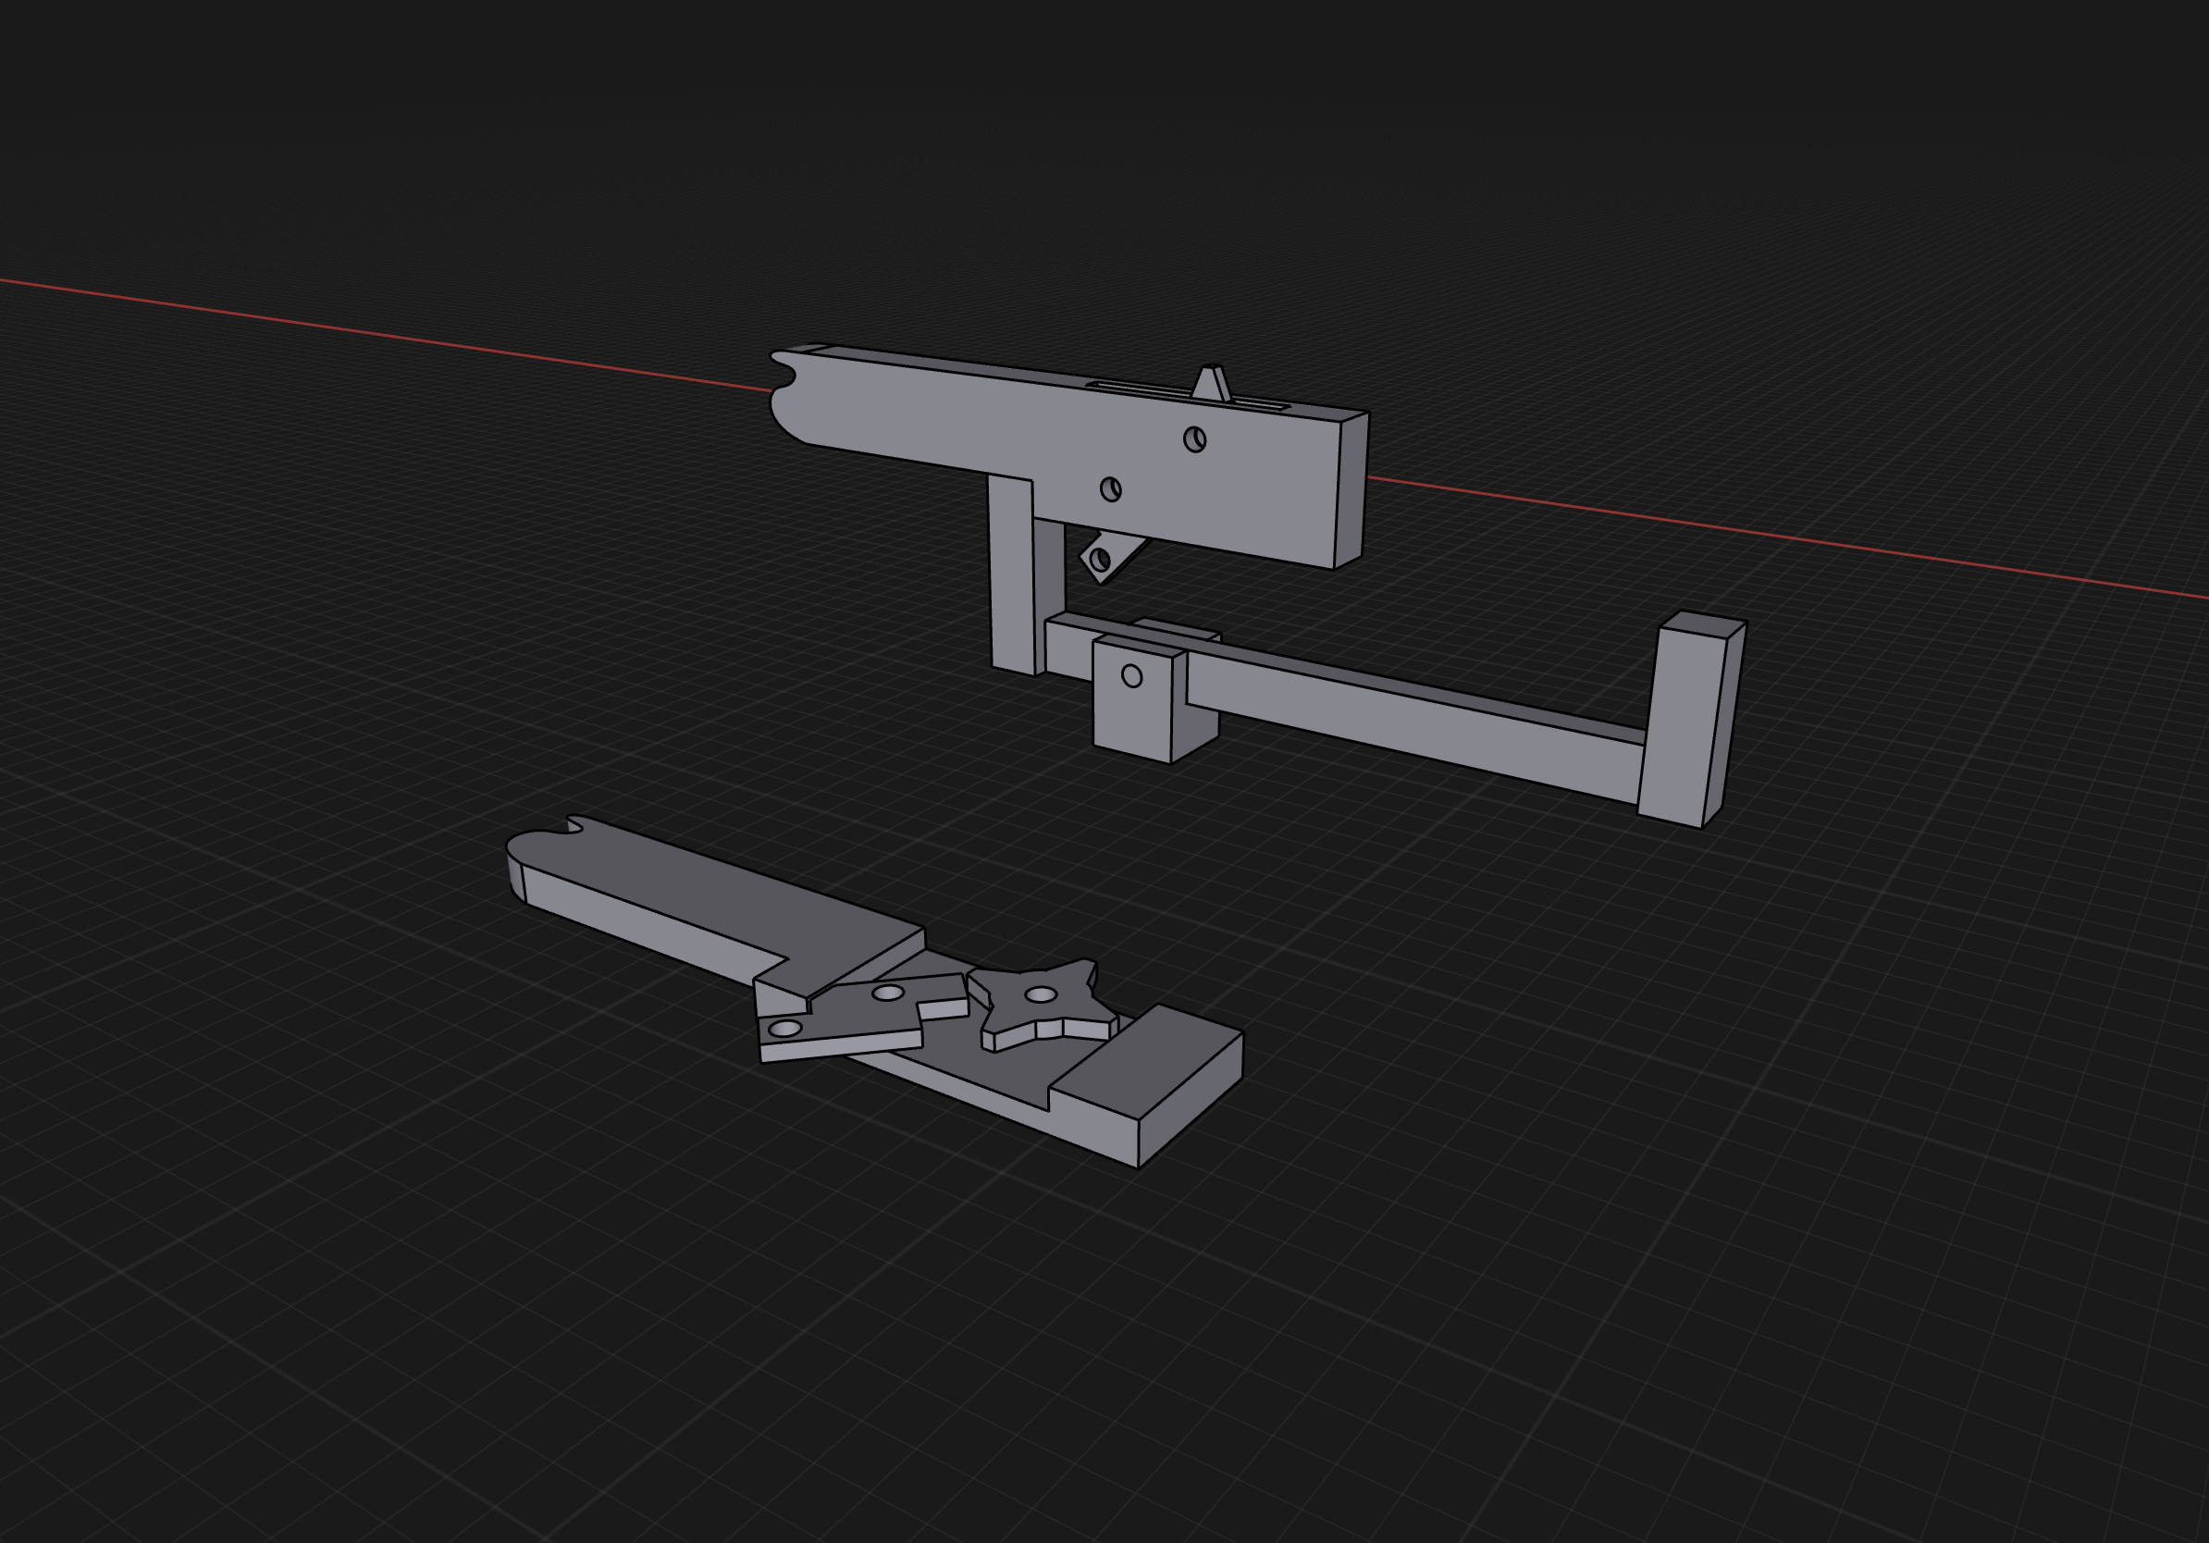
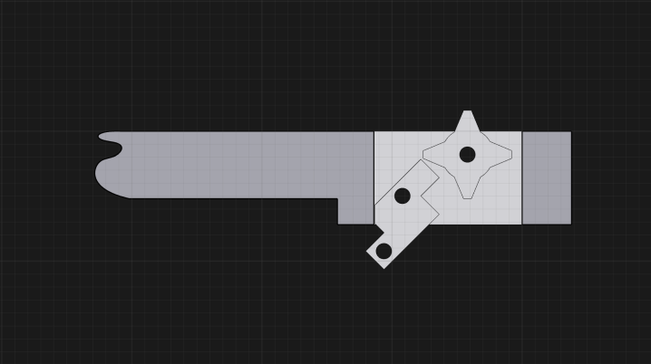
Project Sketch
3D Models for the rubber band gun
Gear
Body
Trigger

Slide 9
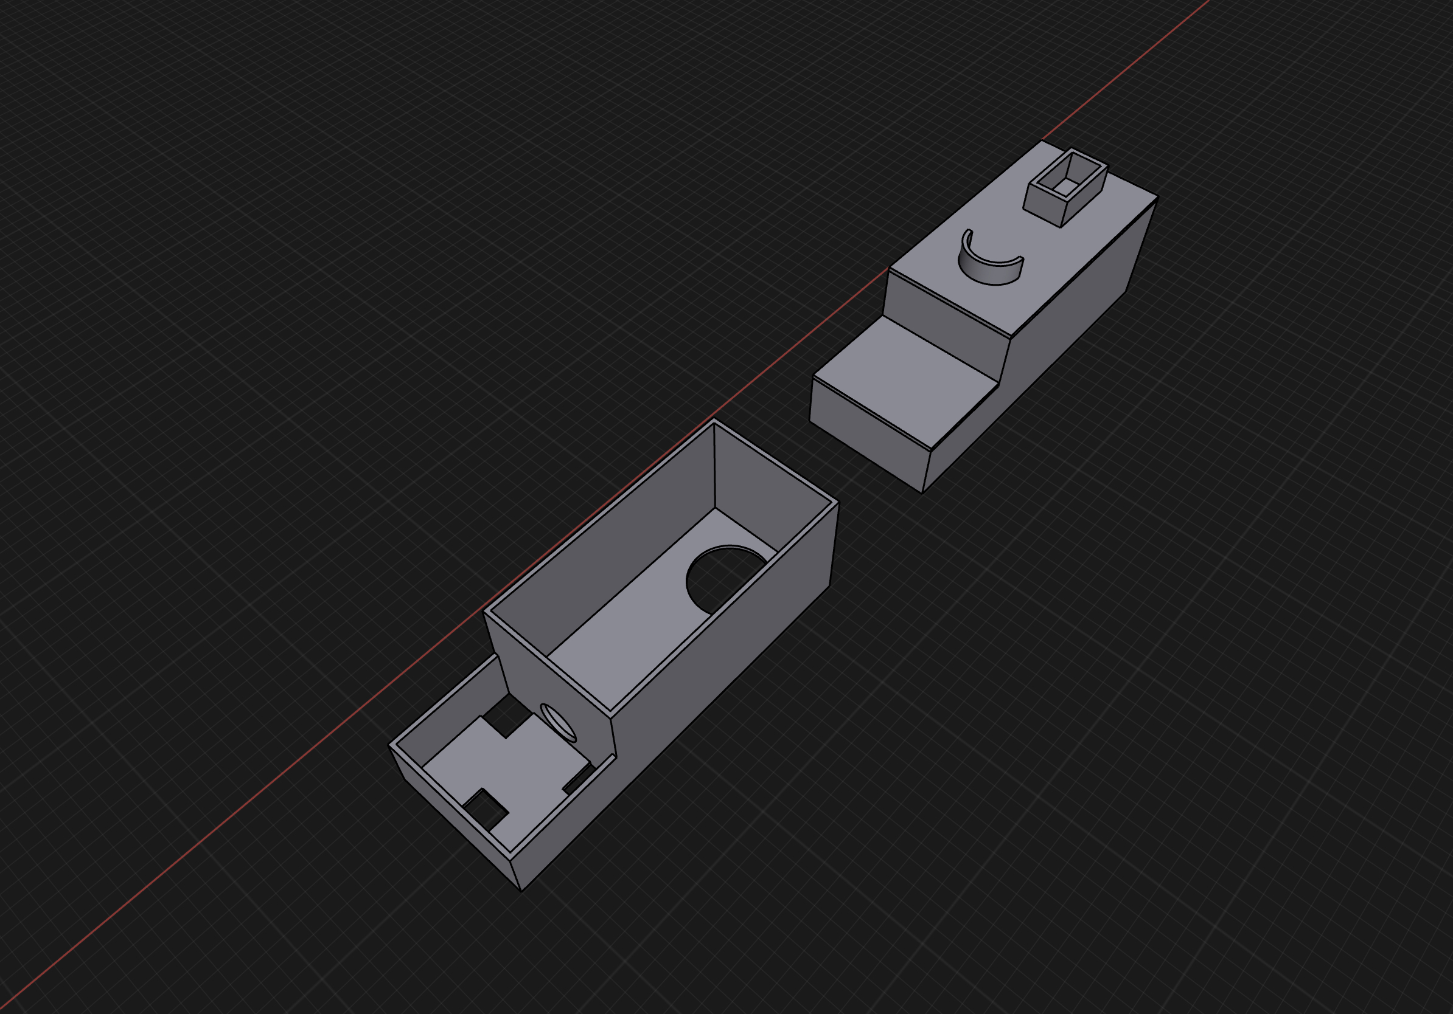
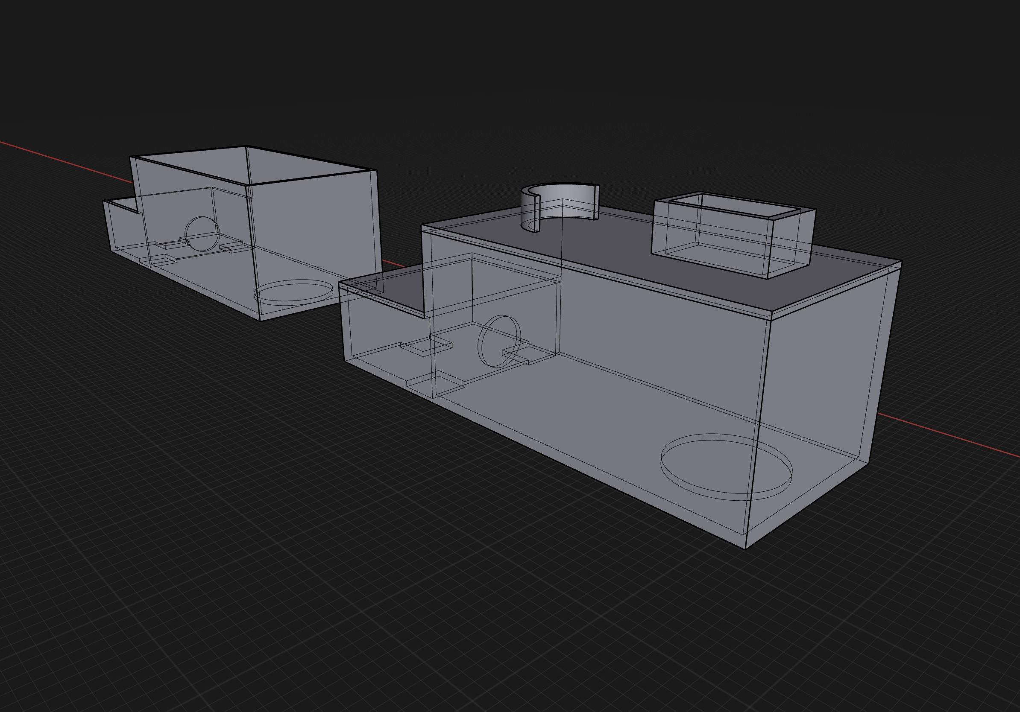
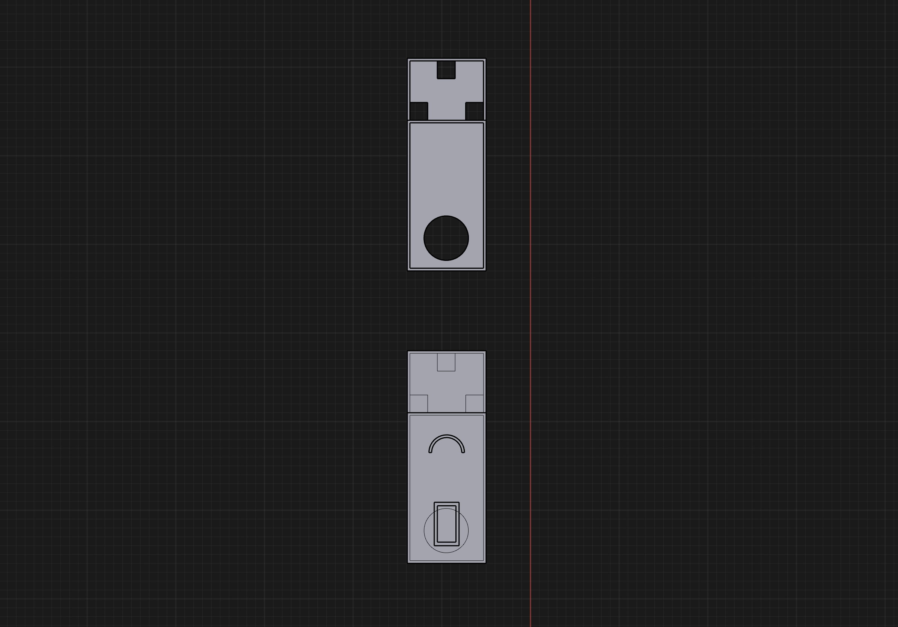
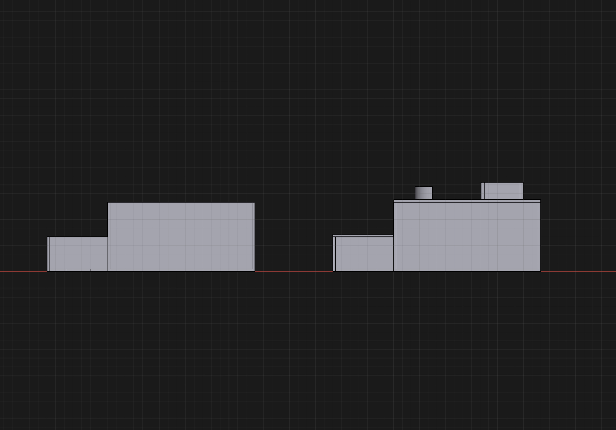
Project sketch
Rover Chassis

Slide 10
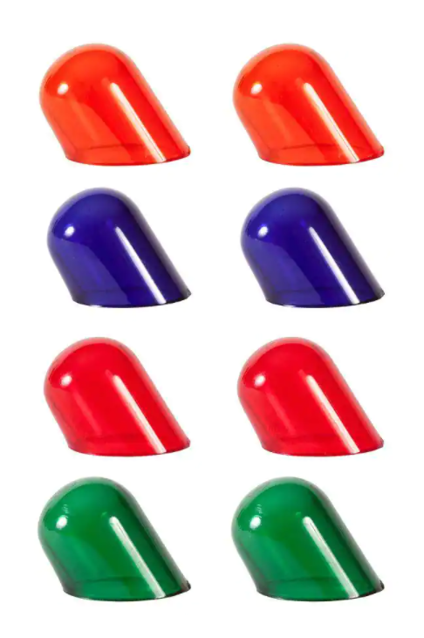


Hardware
Light Filtration

Slide 11
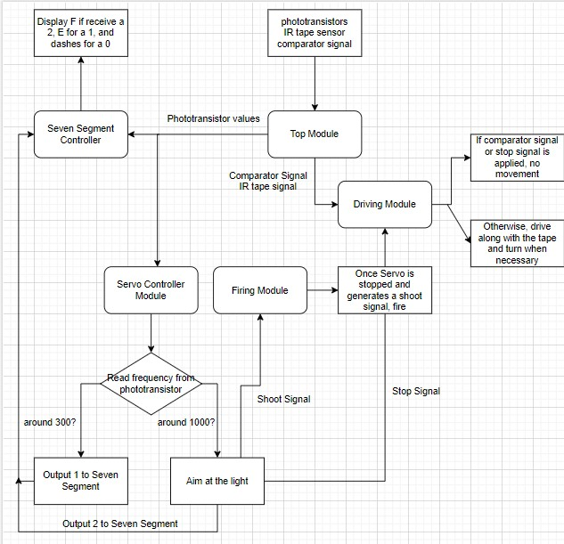
Software
Flow Chart

Slide 12
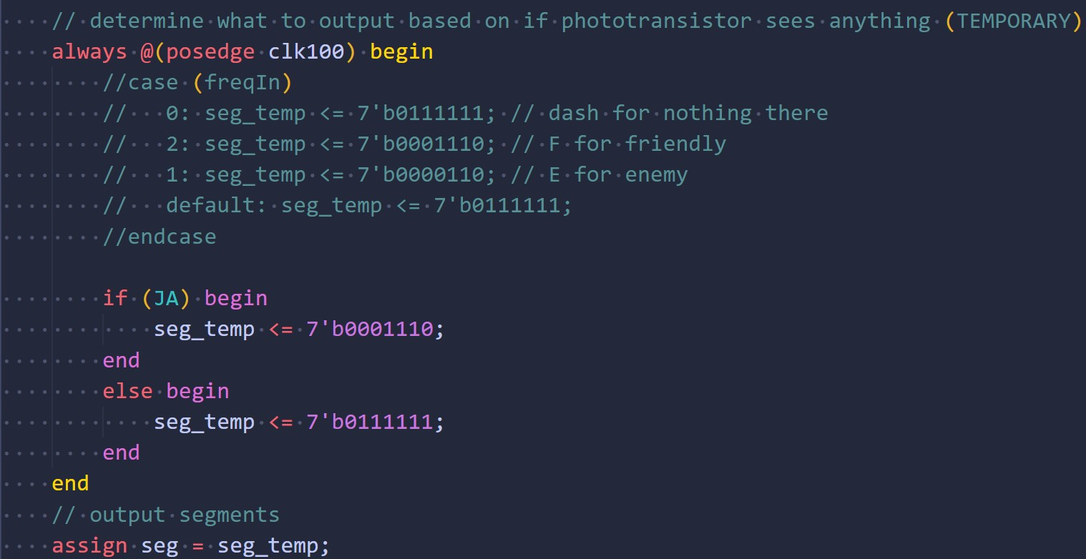
Software
Seven Segment Update

Slide 13
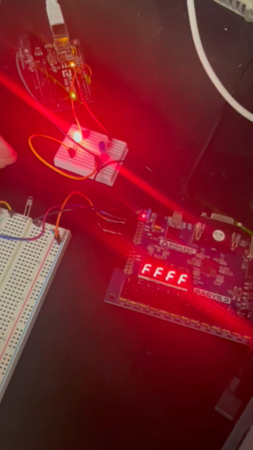
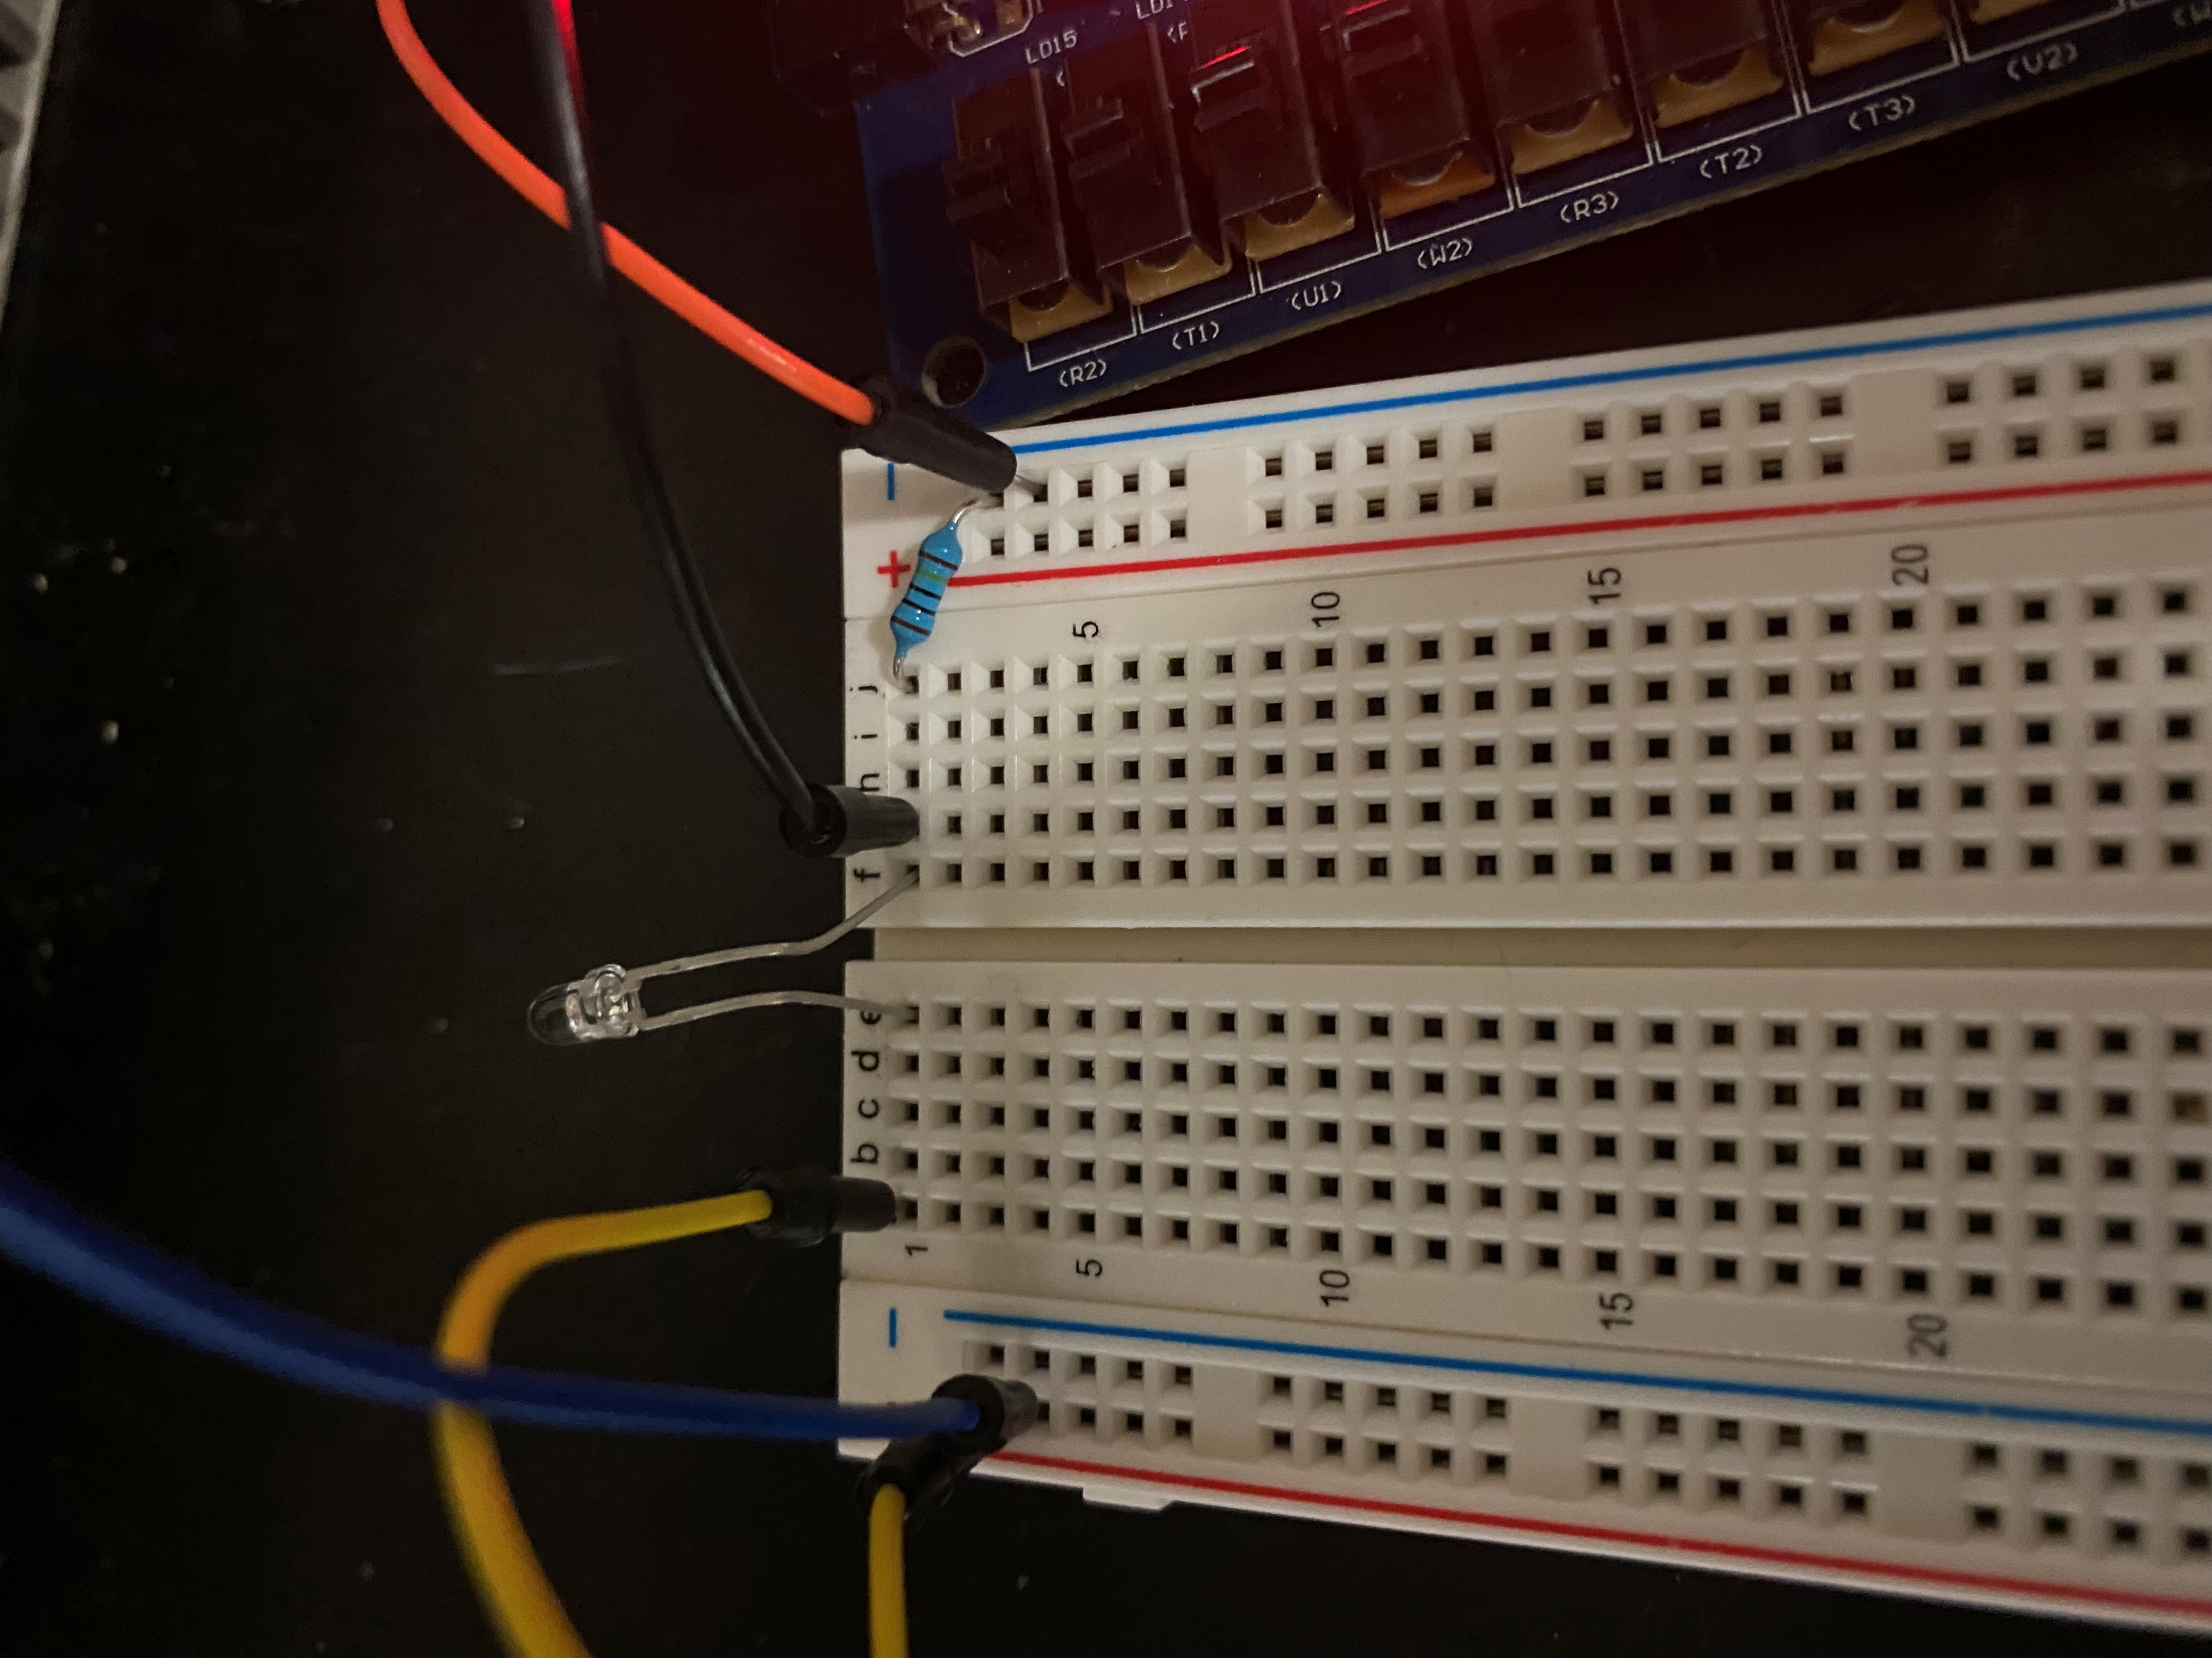
Software
Phototransistor Test

Slide 14
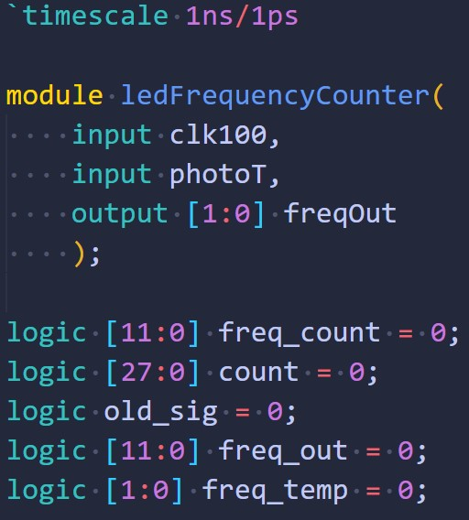
Software
Frequency Counter pt. 1

Slide 15
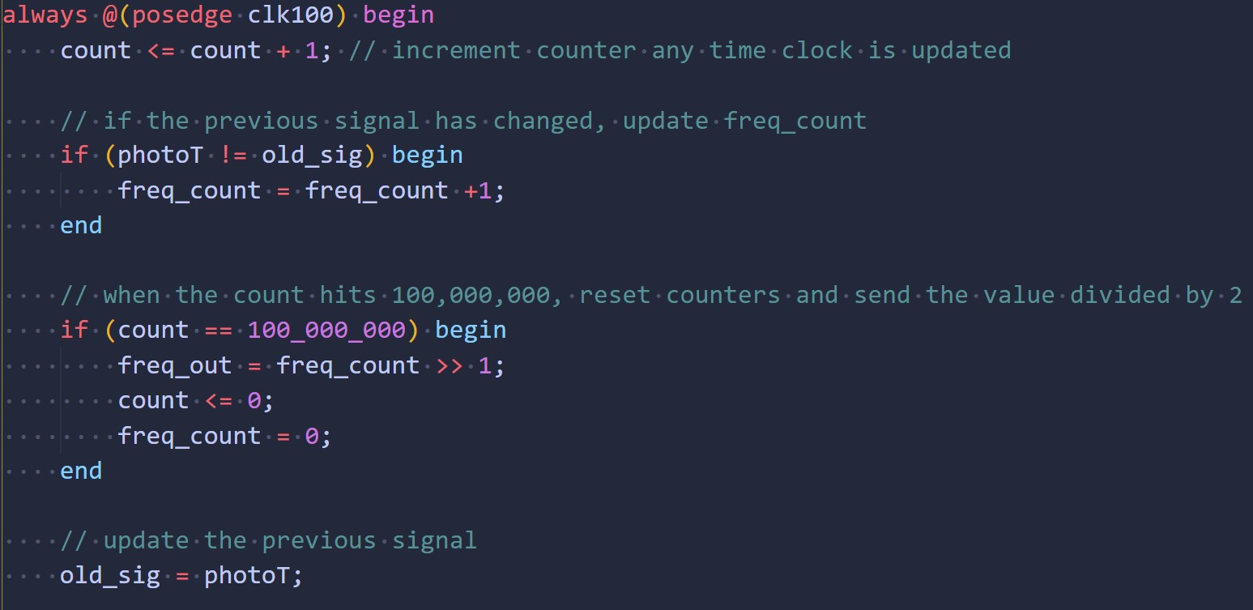
Software
Frequency Counter pt. 2

Slide 16
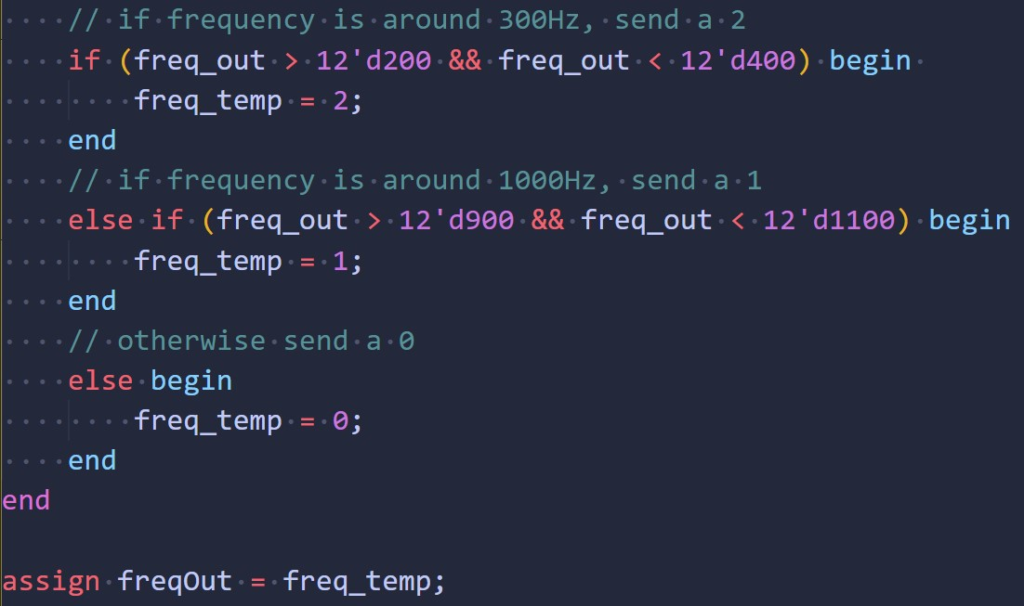
Software
Frequency Counter pt. 3

Slide 17
Gantt Chart

Slide 18
Overall Budget

Slide 19
Labor Hours and Material costs

Slide 20

Questions
Software Manager: Dirk Thieme
Hardware Manager: Erik Manis
Project Controller: Mohammed Ansari
This Photo by Unknown author is licensed under CC BY.

